Slide 1
COLLEGE ONLINE VOTING SYSTEM

Slide 2
Abstract
The College internet Voting System is an internet platform that streamlines and automates online polls and elections.
Every user is interacting with the system on their own.
The user's browser is used for all remote user interaction.
Voters should first fill out the registration form and submit their information.
This information is compared to the information in the college database; On Election Day alone, users check in to the system with their username and password and cast their votes.
There are two user levels in this system: administrator and voter levels.

Slide 3
Over view of the project
The main conduit between the student body and the administration is provided by university student leaders. In accordance with the university act, these leaders are so democratically elected to represent the interests of the student body
Our focus in this project, College Online Election, is on the web-based voting framework process that is used to identify the real voters.
The system comprises two primary modules: Admin and Student. The Admin is responsible for managing the system, including logging in, adding candidate details, and overseeing the election process.
Once the candidates are registered, students can participate in the voting process by first registering on the platform and logging into their accounts.
After authentication, students can view the list of candidates along with their details before casting their votes securely.
The system ensures that each student can vote only once, preventing any fraudulent activities.

Slide 4
Problem Description
The Online College Voting System is a web-based application designed to digitize and streamline the election process within a college environment, ensuring fairness, security, and transparency.
The system consists of two primary modules: Admin and Student.
The Admin is responsible for managing the system, including logging in, adding candidate details, overseeing the election process, and publishing the final results.
Students can register and log into the system to participate in the voting process. After authentication, they can view candidate details and cast their votes securely.

Slide 5
Modules
ADMIN
Login
View Request
Accept/ Reject
Add Candidate
Update Voting Result

Slide 6
VOTER
Register
Login
View Candidate
Vote
View Result

Slide 7
Modules
Admin
Login
In this module, the admin can login in the system using his/her username and password.
Approve/ reject request
In this module, the admin can approve/ reject the candidate request.
Add Candidates
In this module, the admin can add the candidate information like candidate name, id, phone number, mail id, location etc.

Slide 8
Update Result
In this module, the admin can update the status of the vote result.
Student
Register
In this module, there is registration form available where new student can create their account by providing required information to the system. The registration form details are like name, email, gender, mobile number, address, and etc. These details are stored in the database. And then can getting to the username and password in the system.

Slide 9
Login
In this module, the student can login the system using his/her user name and password.
View Candidates
In this module, the voter can view the candidate details like candidate name, id, phone number, mail id, location etc.
Vote poll
In this module, user can view the candidate details who are stand for the voting and vote the particular candidate.
View result
In this module, user can view the vote result updated by the admin.

Slide 10
Hardware Requirements
Processor : Dual core processor 2.6.0 GHZ
RAM : 4 GB
Hard disk : 500 GB
Keyboard : Standard keyboard
Monitor : 15 inch color monitor

Slide 11
Software Requirements
Operating system : Windows OS
Front End : PHP
Back end : MySQL server
Tool : Macromedia Dreamweaver 8

Slide 12
Data Flow Diagram
LEVEL 0
Login
Admin
Add Candidates
Update Result
Database

Slide 13
LEVEL 1
Login
User
View Candidate Details
Vote Poll
View Result
Database

Slide 14
Database Design
Table Name: admin
Column | Type | Null | Default
name | varchar(50) | No | NULL
psw | varchar(50) | No | NULL

Slide 15
Table Name: candidates
Column | Type | Null | Default
id | int(11) | No | NULL
name | varchar(255) | No | NULL
position | varchar(255) | No | NULL
party | varchar(255) | No | NULL
experience | int(11) | No | NULL
bio | text | No | NULL
manifesto | text | No | NULL
photo | varchar(255) | No | NULL
election_id | int(11) | No | NULL

Slide 16
Table Name: elections
Column | Type | Null | Default
id | int(11) | No | NULL
name | varchar(255) | No | NULL
description | text | Yes | NULL
start_date | date | No | NULL
end_date | date | No | NULL
results_announced | tinyint(1) | Yes | 0

Slide 17
Table Name: stureg
Column | Type | Null | Default
id | int(11) | No | NULL
name | varchar(255) | Yes | NULL
dob | date | Yes | NULL
gender | varchar(10) | Yes | NULL
email | varchar(255) | Yes | NULL
year | varchar(20) | Yes | NULL
dep | varchar(50) | Yes | NULL
uname | varchar(50) | Yes | NULL
psw | varchar(255) | Yes | NULL
status | enum(&#039;pending&#039;, &#039;approved&#039;, &#039;rejected&#039;) | Yes | pending

Slide 18
Table Name: votes
Column | Type | Null | Default
id | int(11) | No | NULL
student_id | int(11) | Yes | NULL
candidate_id | int(11) | Yes | NULL
election_id | int(11) | No | NULL
disabled | tinyint(1) | Yes | 0

Slide 19
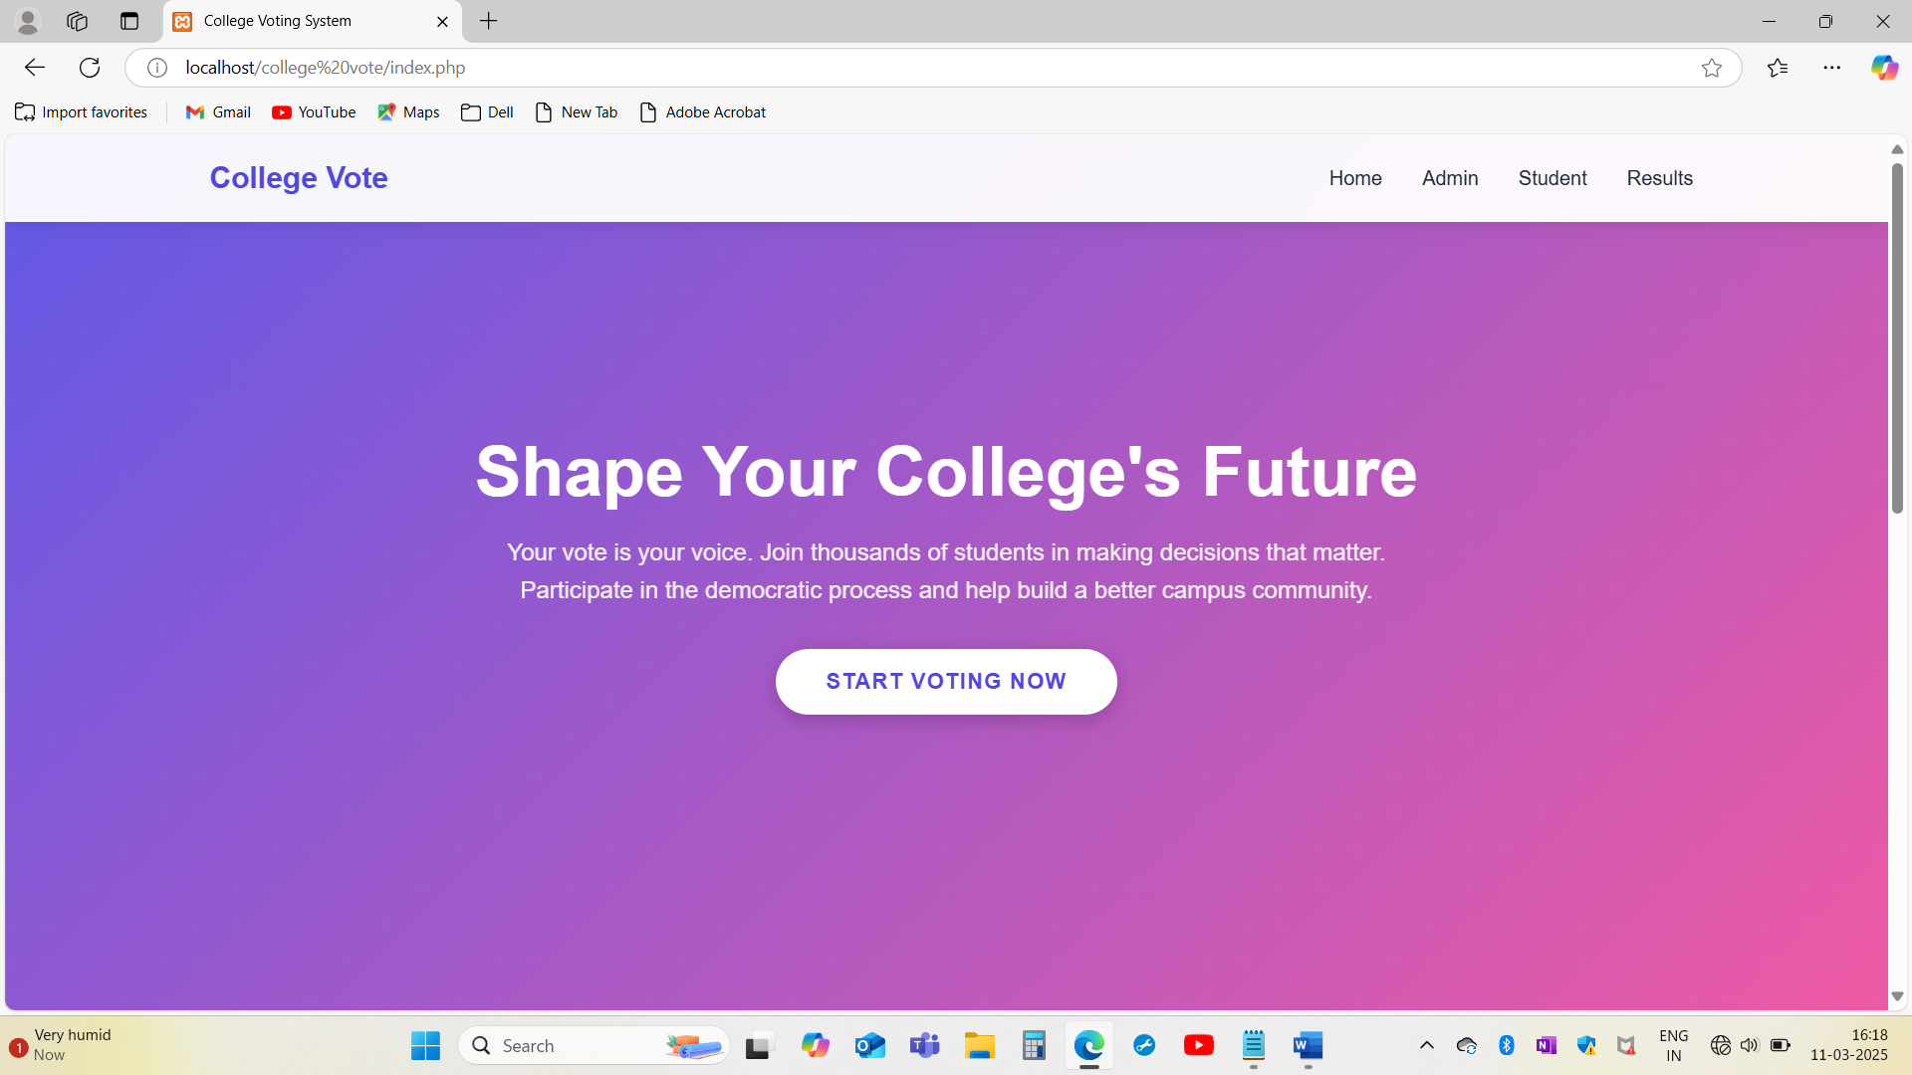
Screenshots

Slide 20
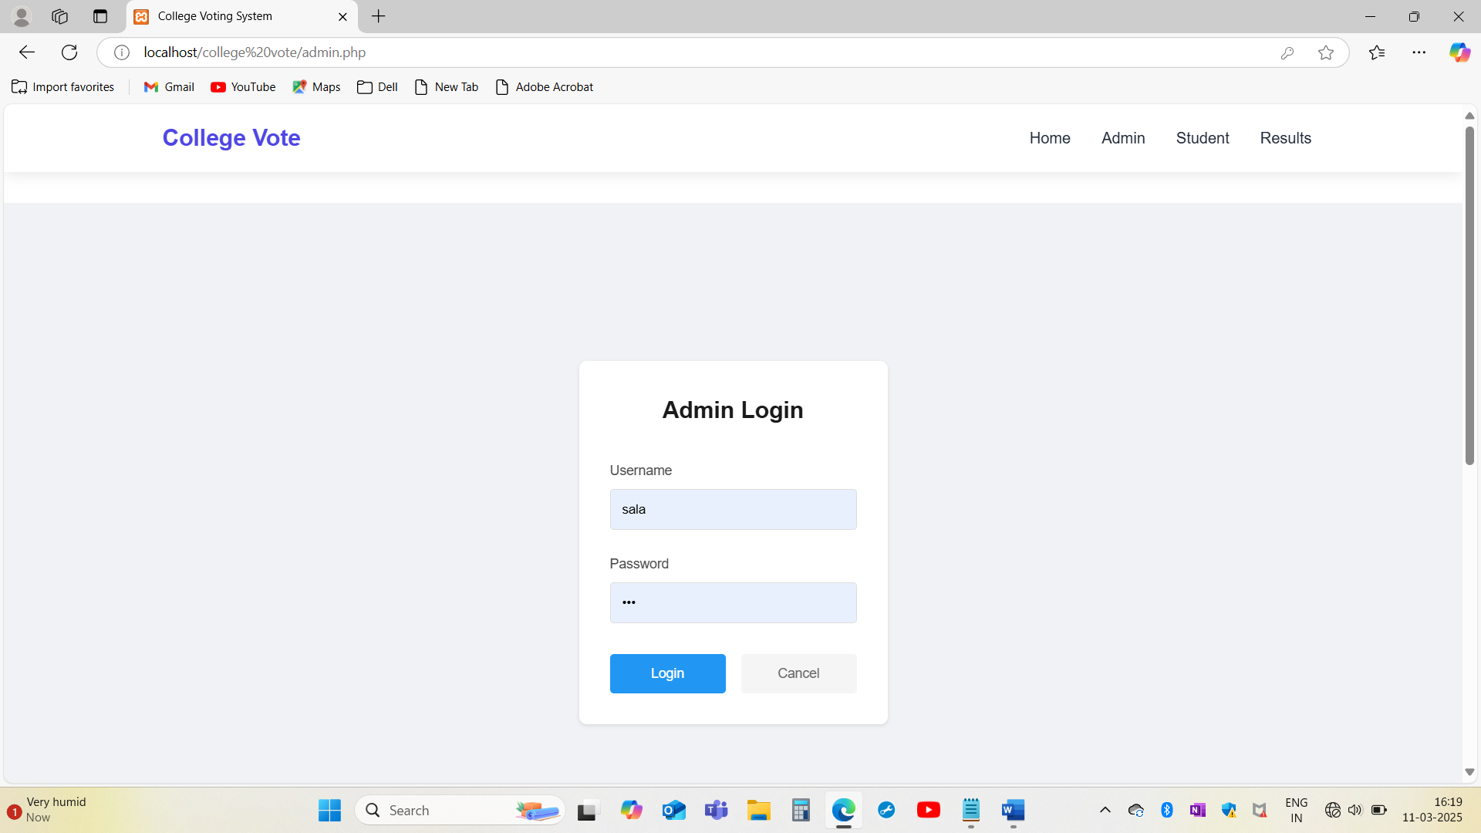

Slide 21
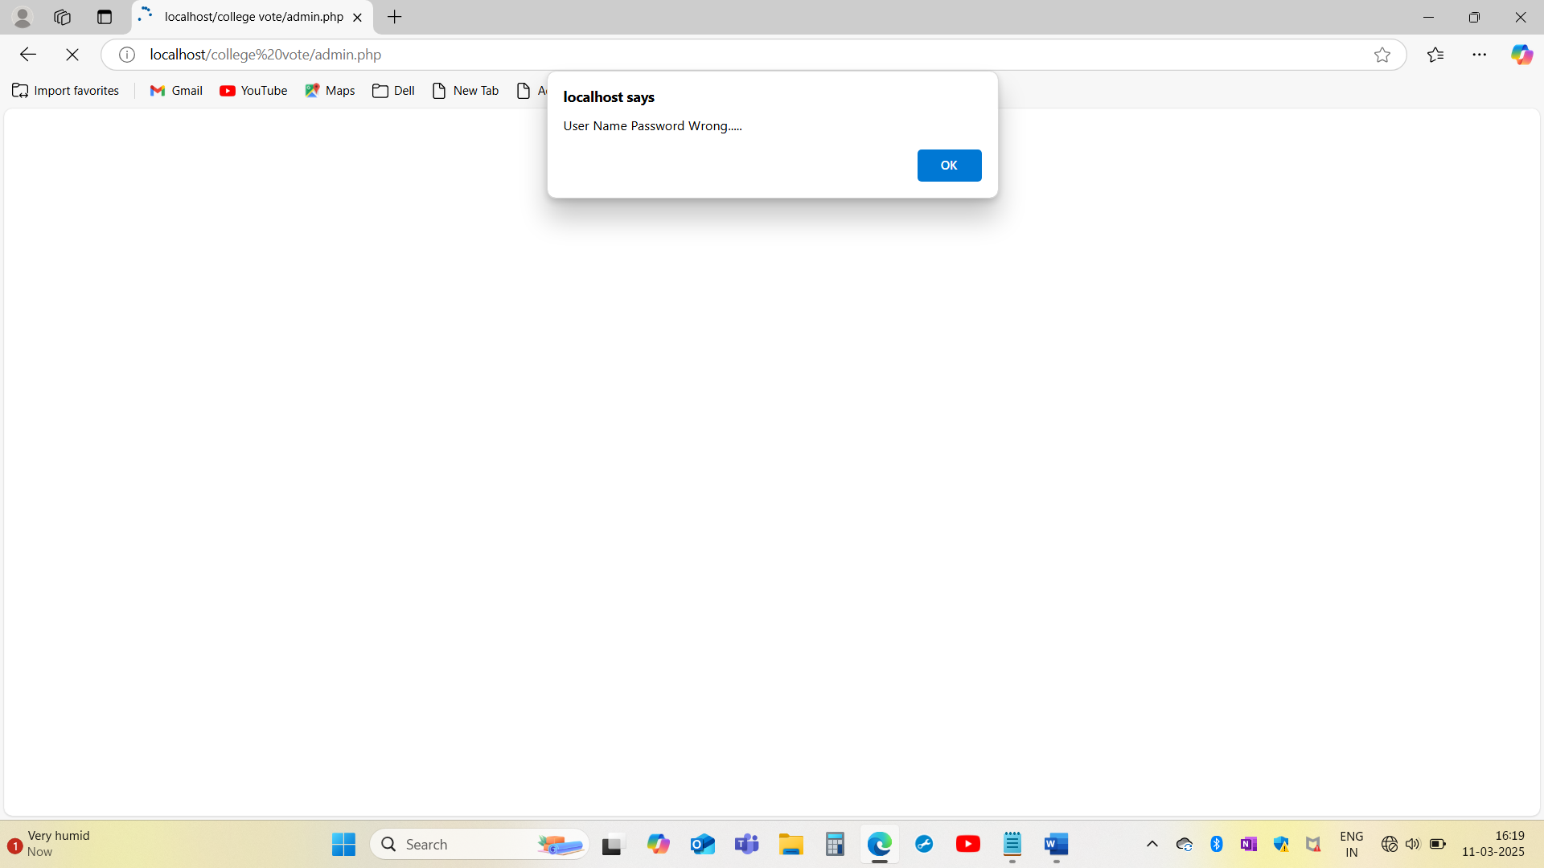

Slide 22
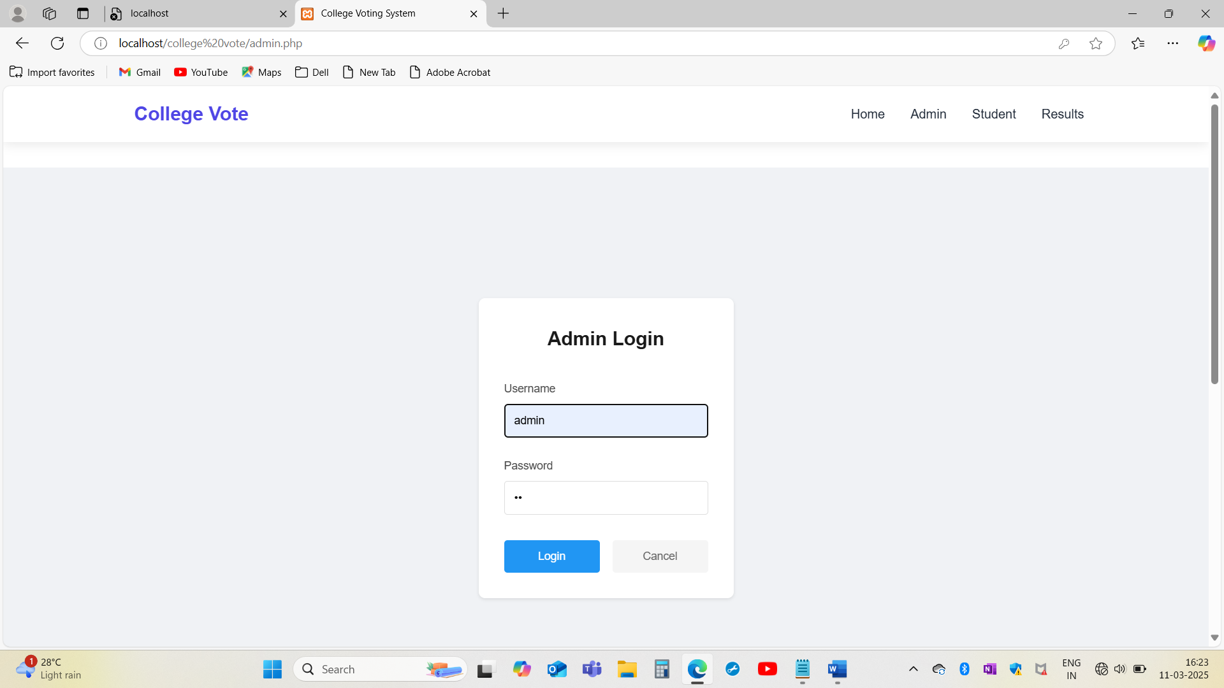

Slide 23
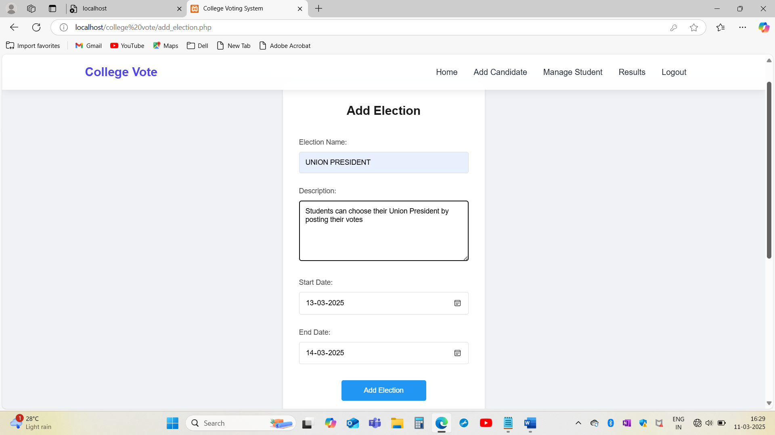

Slide 24
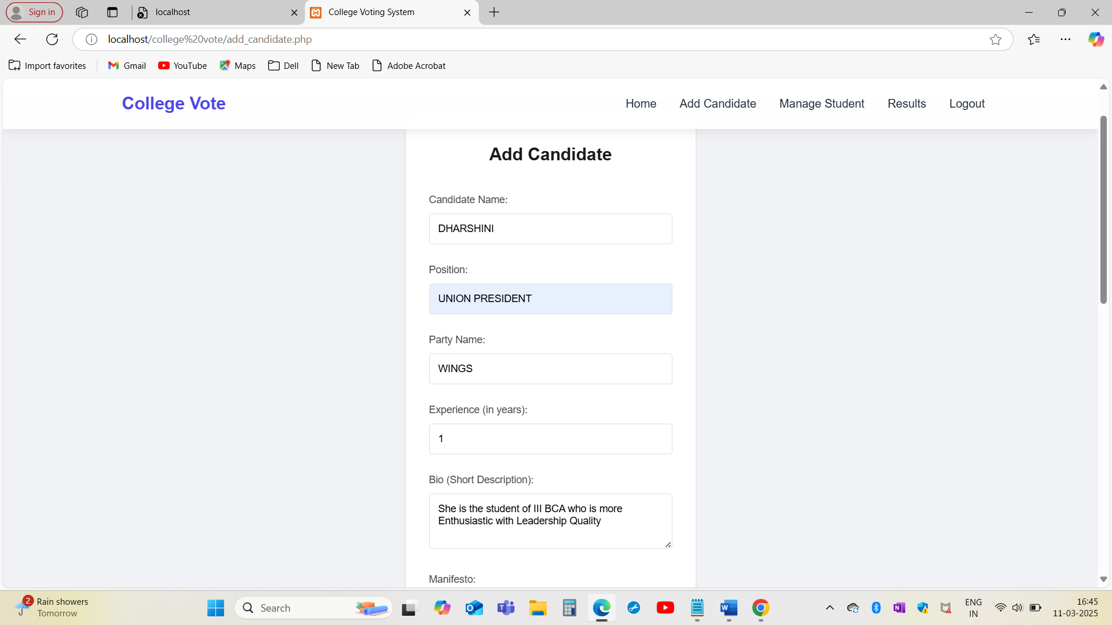

Slide 25
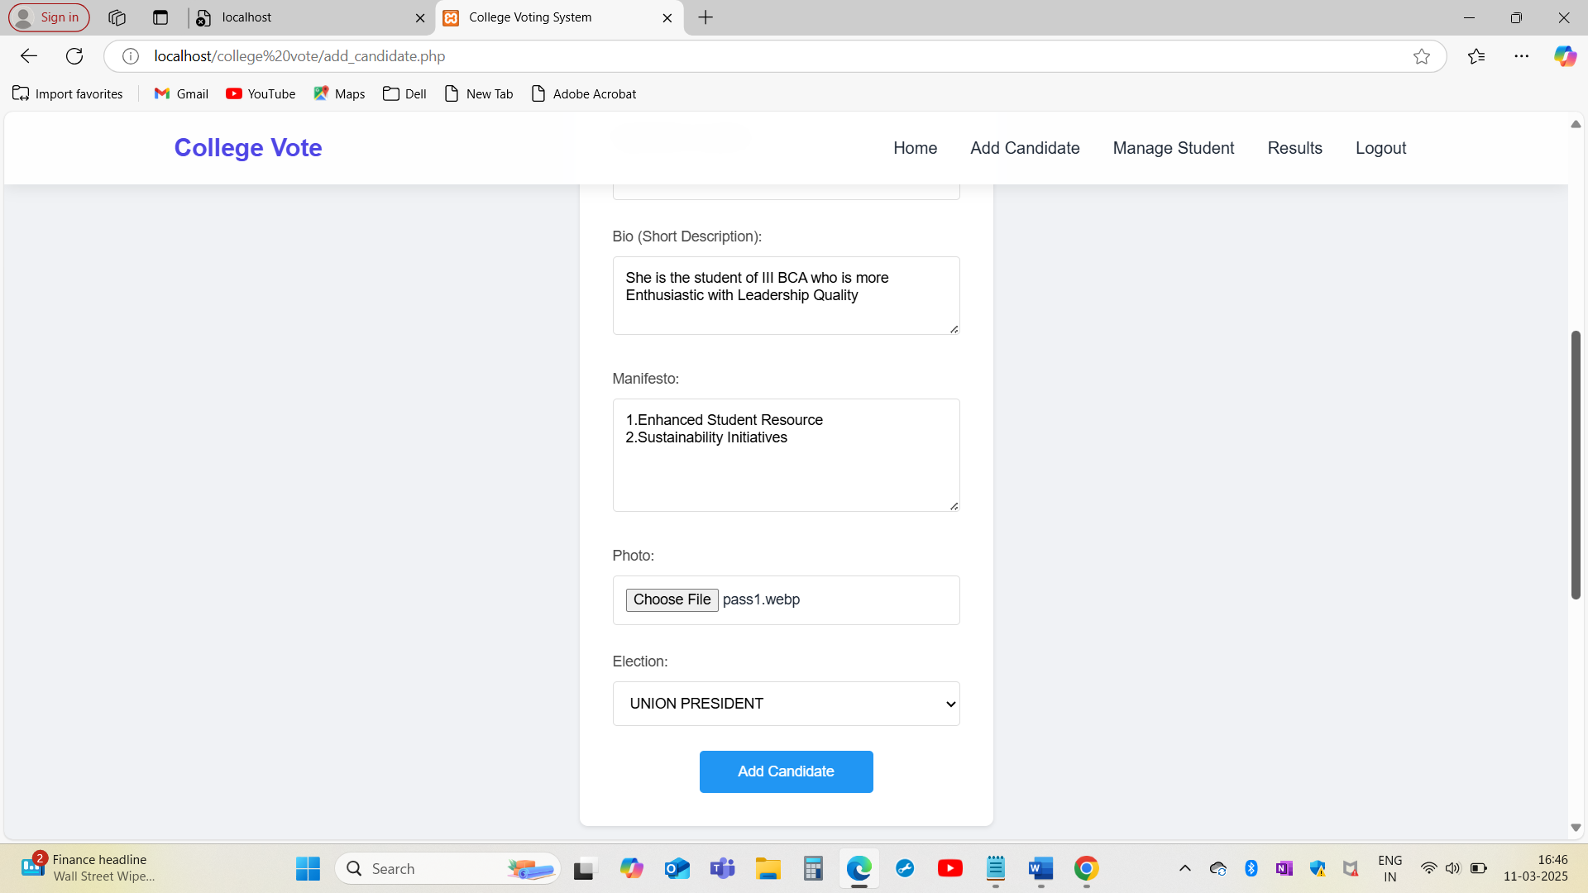

Slide 26
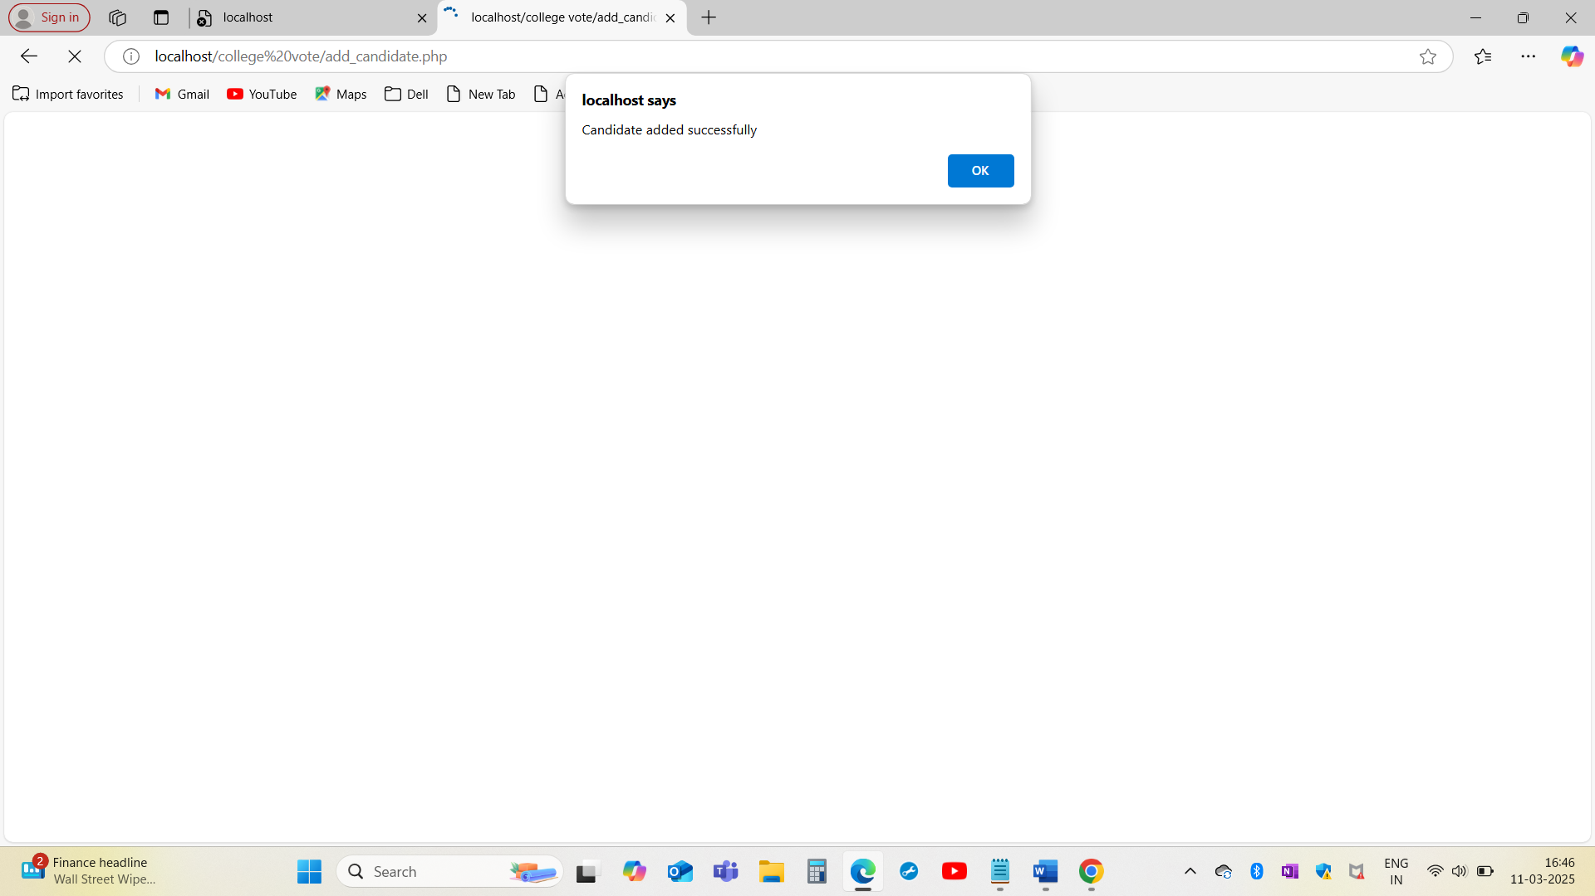

Slide 27
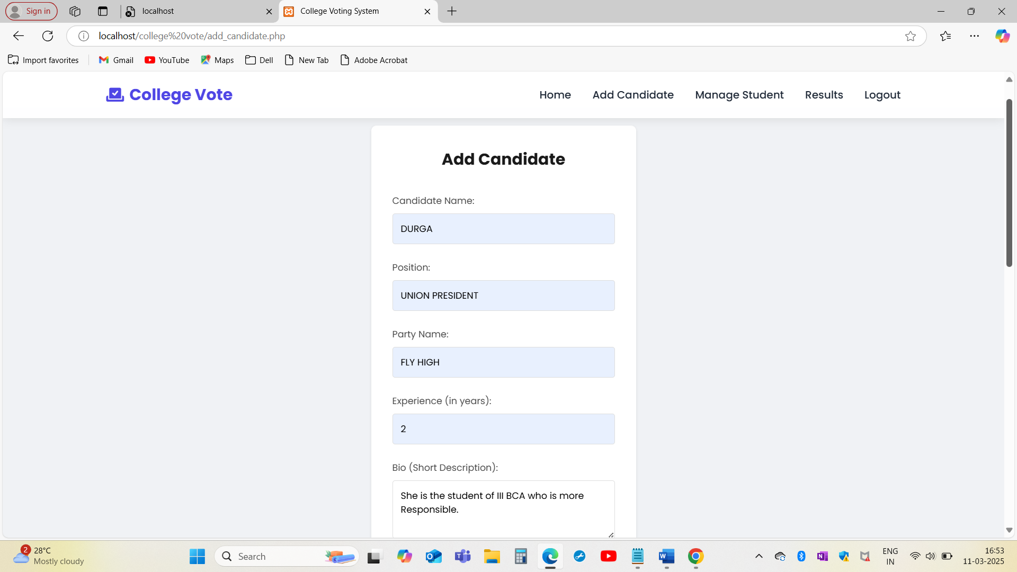

Slide 28
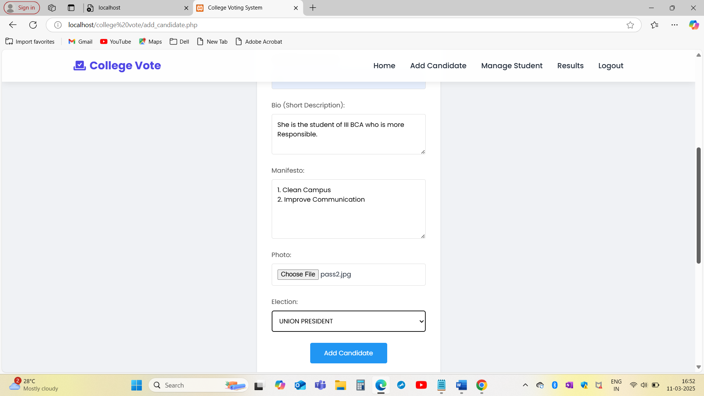

Slide 29
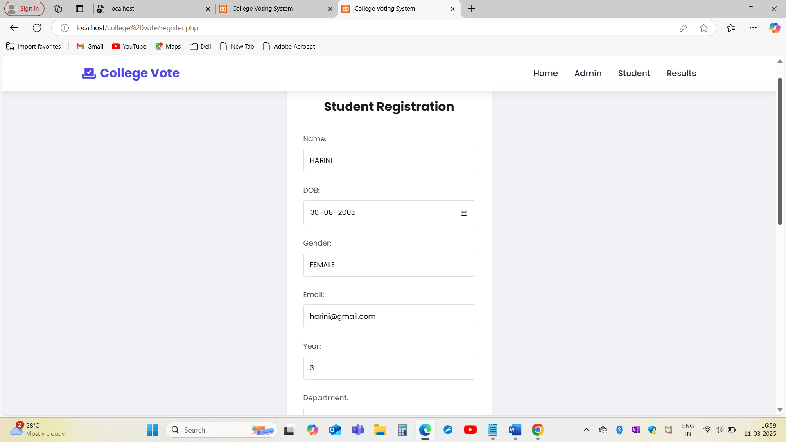

Slide 30
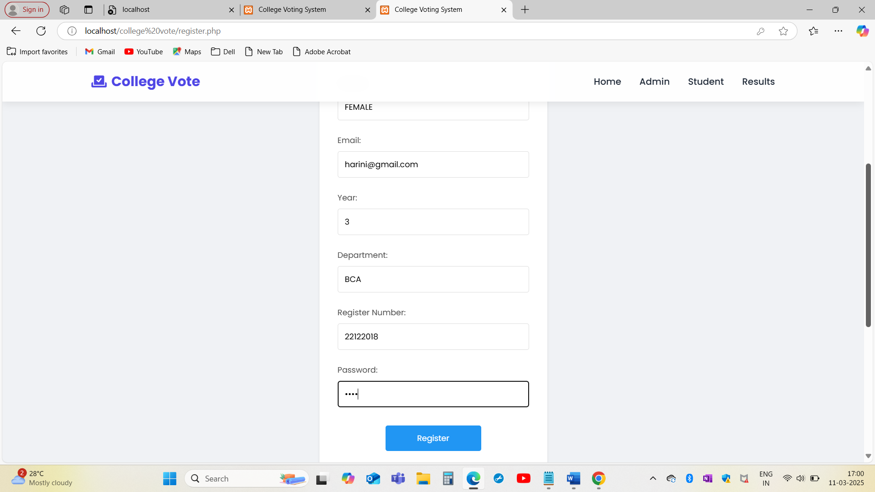

Slide 31
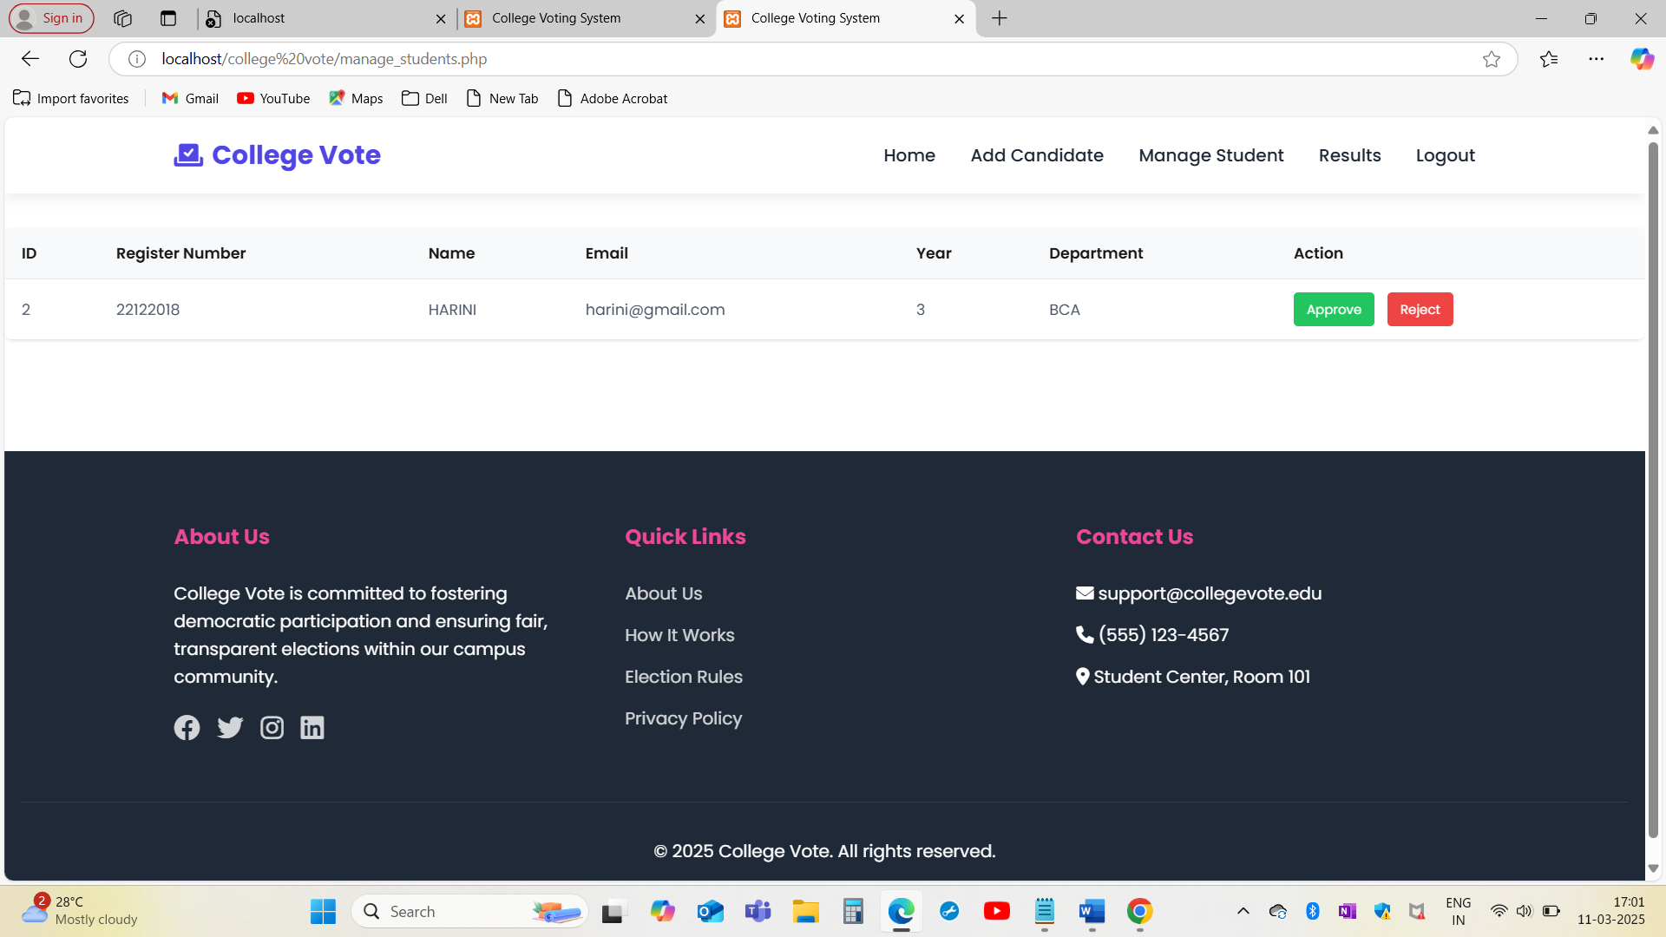

Slide 32
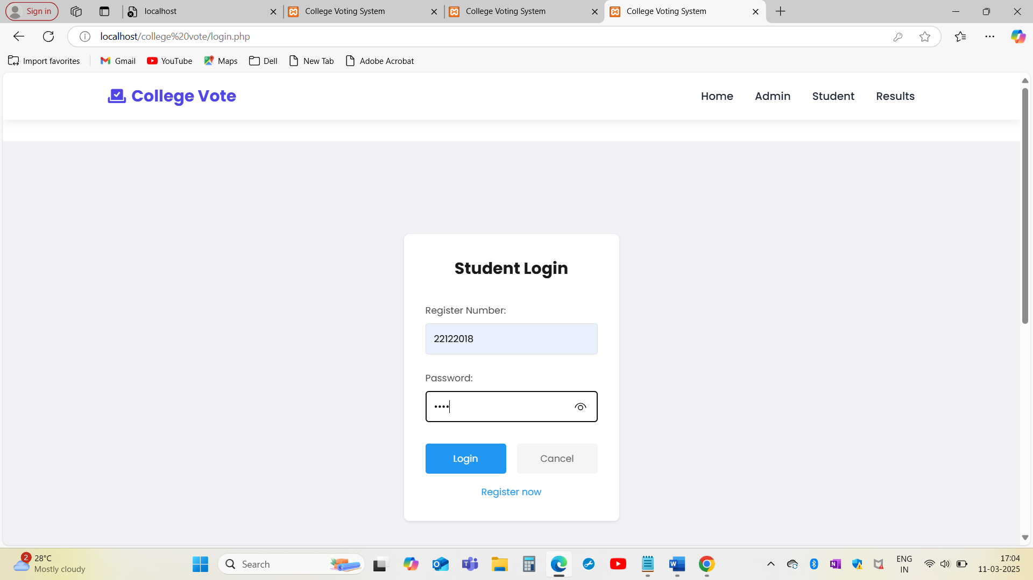

Slide 33
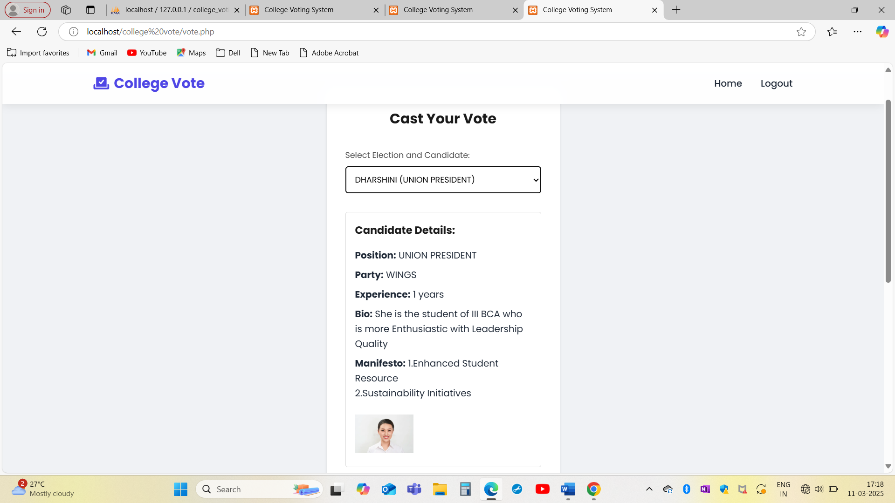

Slide 34
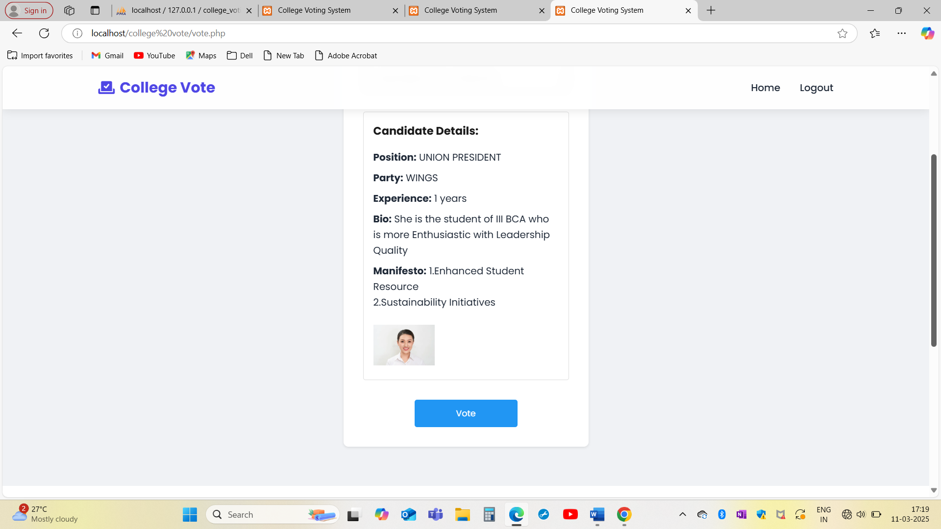

Slide 35
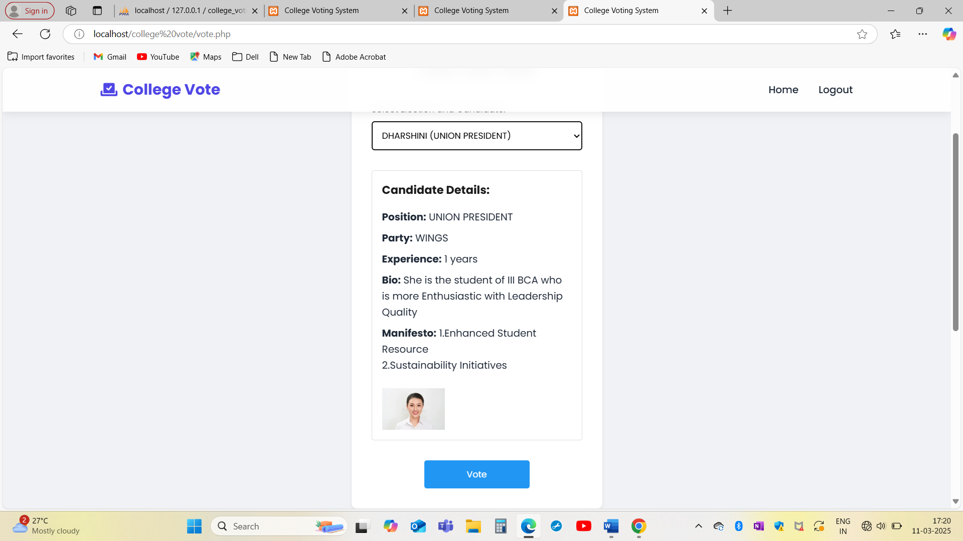

Slide 36
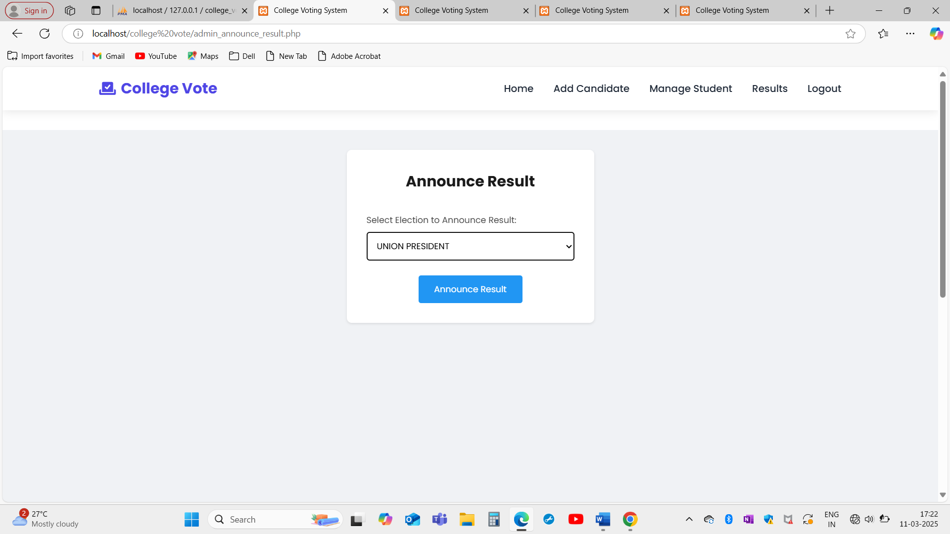

Slide 37
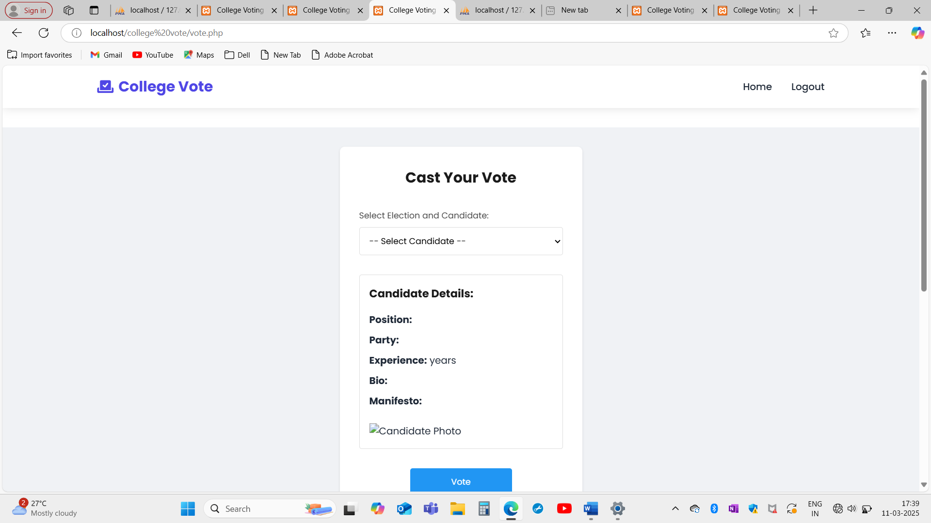

Slide 38
Conclusion
In conclusion, the college voting system offers a streamlined and efficient way for students to participate in the democratic process of electing their representatives.
By implementing a secure and user-friendly platform, the system ensures transparency, accuracy, and ease of access for students to cast their votes.
The use of technology reduces the chances of fraud or errors, and the system provides real-time results, ensuring that the process is smooth and timely.

Slide 39
References
Felke-Morris, Web Development & Design Foundations with HTML5, 10th Edition, Addison-Wesley, 2020.
W3Techs - World Wide Web Technology Surveys. W3Techs. 26 April 2021. Retrieved 26 April 2021.
Learning PHP,MySQL With jQuery, CSS & HTML5 (Learning PHP, MYSQL, Javascript, CSS & HTML5) Robin Nixon - Jun 12, 2018.
PHP & MySQL: Server-side Web Development is the long-awaited book by author Jon Duckett. 2022

